Slide 1

Startup Investment Analysis | Shark Tank India Prepared by: Geetanjali Kaushik Tools: Python | Power BI

Slide 2
1. Project Introduction
This project is based on Shark Tank India startup investment data. The main objective was to analyse startup funding trends, investor behaviour, and founder success patterns using Python for data cleaning and Power BI for dashboard creation.
The final dashboard was divided into three pages:
Investment Overview
Investor Investment Analysis
Founder & Business Performance Analysis

Slide 3
2. Tools Used :
I used:
Python (Pandas, NumPy) for data cleaning and preprocessing
Power Query for reshaping investor-wise data
Power BI for dashboard design and analysis
DAX for KPIs and calculated measures

Slide 4
3. Problem Statement
The purpose of this project was to answer key business questions such as:
Which industries receive the highest funding?
Which investors contribute the most capital?
Does founder team size affect funding success?
Do revenue and patents influence investment decisions?
This helped convert raw startup pitch data into meaningful business insights.

Slide 5
4. Python Workflow
Step 1: Import Dataset
I loaded the CSV file into Python using Pandas.
Step 2: Understand the Data
I checked:
number of rows and columns
column names
missing values
data types
Step 3: Clean the Data
I cleaned:
numeric columns
blank values
column names
formatting inconsistencies
Step 4: Create New Business Columns
I created:
Funding Success
investor-based cleaned fields
structured numeric columns for analysis
Step 5: Export Cleaned File
I saved the final cleaned dataset as a CSV and imported it into Power BI.

Slide 6
5. Power BI Workflow
After Python cleaning, I imported the cleaned dataset into Power BI.
Then I performed:
Data modelling
Power Query transformations
DAX calculations
Dashboard design

Slide 7
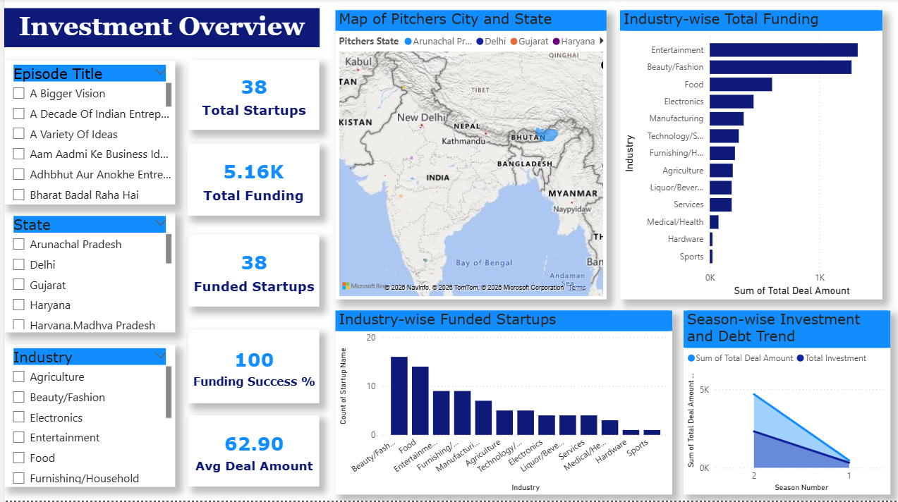
6. Investment Overview (Page 1)
This page gives the overall startup funding picture.
It includes KPIs such as:
38 total startups
5.16K total funding
38 funded startups
100% funding success
62.90 average deal amount
Insights from this page:
Some industries attract more funding than others.
Beauty/Fashion, Food, and Entertainment appear among the stronger sectors in the dashboard visuals.
Funding trends also vary by season and geography.

Slide 8
7. Investor Investment Analysis (Page 2)
This page focuses on investor behaviour.
I transformed investor amount columns into a long format using Power Query so that I could analyse:
investor-wise total capital deployment
deal participation count
average investment per deal
The dashboard shows total investment of 2.64K and average investment per deal of 32.15, along with investor rankings and startup-wise deal details.
Insights : -
A few investors contribute most of the funding.
Some sharks invest more money in fewer deals.
Others participate in more deals with smaller ticket sizes.
Dashboard Image is available on the next page

Slide 9
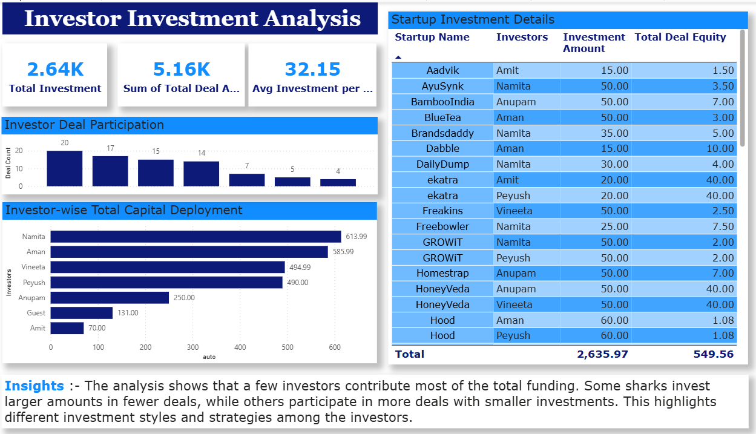
Dashboard Page 2 – Investor Investment Analysis

Slide 10
8. Founder & Business Performance Analysis (Page 3)
This page connects founder characteristics with funding outcomes.
It includes:
KPI 1 - Average Presenters = 2.32
KPI 2 - Average Yearly Revenue = 1.16K
KPI 3 - Patent Impact % = 1
Visual 1 - funding success vs number of presenters
Visual 2 - gender-based funding distribution
Visual 3 - revenue vs investment pattern
Visual 4 - patent impact on funding
Insights:
Team-based startups often perform better in funding.
Funding varies across male-led, female-led, and mixed teams.
Startups with stronger revenue and patents generally attract more investor interest.

Slide 11
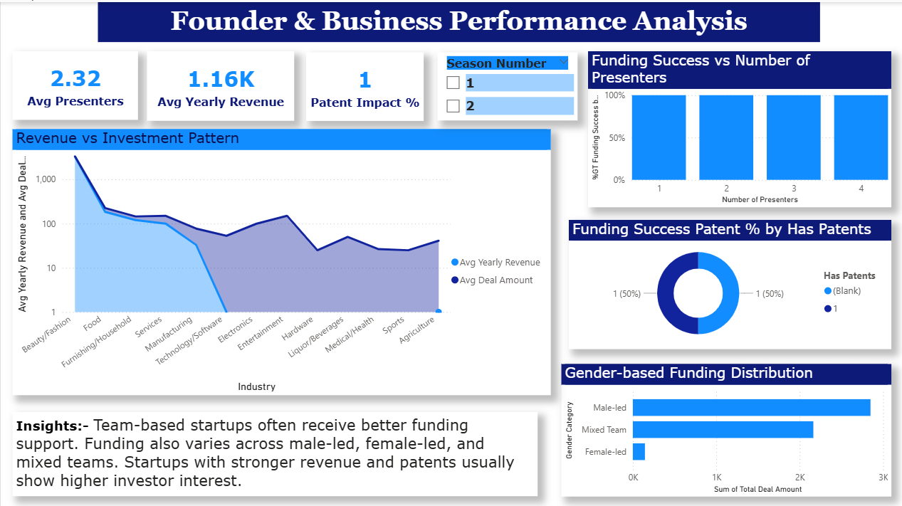
Dashboard Page 3 – Founder & Business Performance Analysis

Slide 12
9. Key Skills Demonstrated
Through this project, I demonstrated:
Python data cleaning
Pandas preprocessing
Power Query transformation
DAX measure creation
dashboard development
business insight generation
data storytelling

Slide 13
10. Final Conclusion
Presentation conclusion:
“This project helped me analyse the Shark Tank India startup ecosystem from multiple perspectives — industry funding, investor behaviour, and founder performance. Python helped me prepare clean and structured data, while Power BI helped me convert that data into interactive dashboards and business insights.”

Slide 14
Thank You ☺

